Slide 1

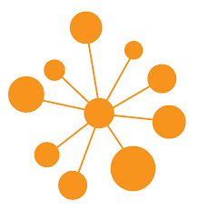
Community Detection:
Twitter ego-network
Arkil Thakkar
Shravani Pande
Sneha

Slide 2
Introduction
High volume of data generated by the social networking sites enables us to identify communities of people with intersecting interests.
This facilitates in observing human behaviors and their network of relations.
Community detection aims on identifying densely connected groups with the motive of understanding their opinions, behavior, preferences.
This can help brands to understand their customers’ choices, analyze political trends and even set up recommendation systems.

Slide 3

Objective
In this project, we aim to detect communities within a twitter ego-network.
To detect the communities, we have considered two factors: 1. How densely the edges in an ego-network are connected. 2. Similarity between nodes in an ego network by considering the features followed by each node.

Slide 4
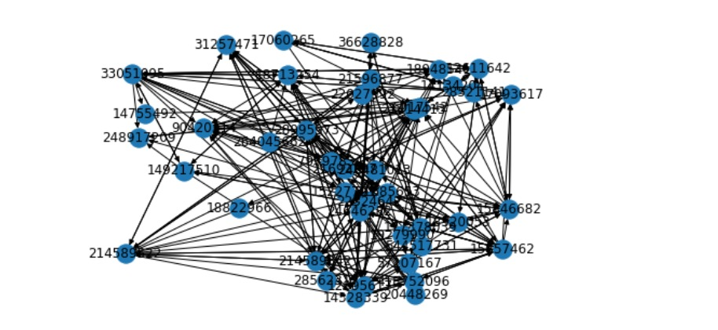
What are ego-networks?
"Ego" is an individual "focal" node. A network has as many egos as it has nodes. Egos can be persons, groups, organizations, or whole societies.
Alters are the nodes to which the ego is directly connected.
Egos and Alters have a social relationship with each other.

Slide 5

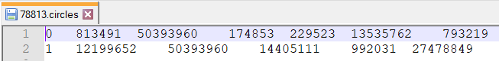
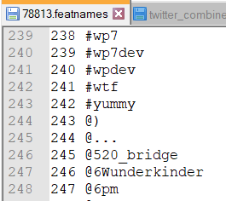
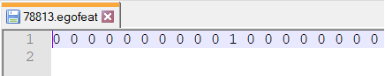
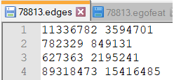
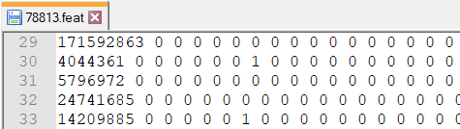
Demystifying the Dataset

Slide 6
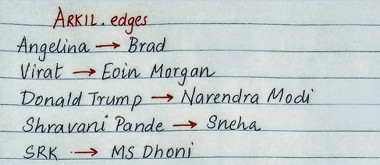
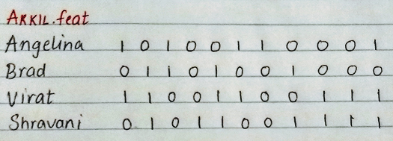
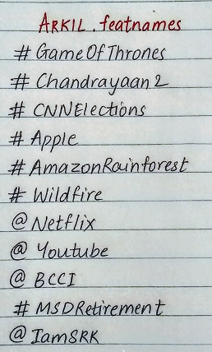
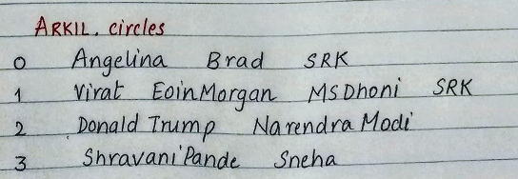
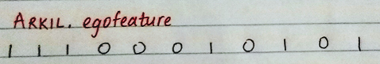
Our understanding of the Dataset

Slide 7
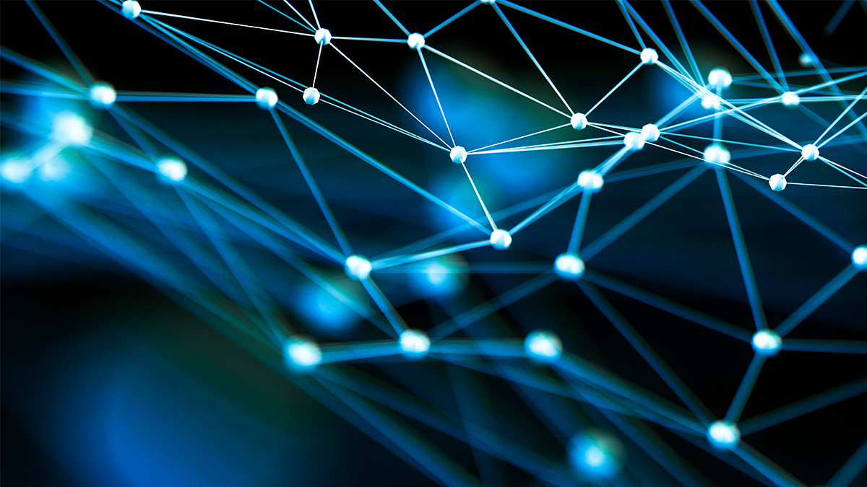
Algorithms considered / used
Louvain
Spectral Clustering
Girvan-Newman
K-cliques

Slide 8
Louvain
Modularity: According to Wikipedia, networks with high modularity have dense connections between the nodes within modules but sparse connections between nodes in different modules.
Fastest among all the modularity based algorithms.
Works in two stages executed iteratively.
Initially, each node in the network is considered as one community.
For each node X, algo considers Y neighbours.
Calculate gain in modularity when X is moved to Y’s community. Keep X in the community where highest modularity is gained.
Iterate these steps.

Slide 9
Spectral Clustering
Spectral clustering is used to identify communities of nodes in a graph based on the edges connecting between them. Spectral clustering uses information from the eigenvalues of the matrices built from the dataset/graph.
Steps: -Created similarity matrix between our N nodes of clusters based on the features. - Compute the first k eigenvalues of its Laplacian matrix to define feature vector for each object. - Run k-means on these features to separate objects into k classes.

Slide 10
Girvan-Newman
Instead of creating communities from scratch, this algorithm finds the edges that are most central to the communities.
Algorithm considers the “edge betweenness” for community detection.
Steps: 1. Calculate the betweenness centrality of al the edges in the network. 2. Remove the edges with the highest betweenness. 3. Recompute the betweenness for all the edges affected by the removal. 4. Repeat the steps 2 and 3 until no such edges remain.

Slide 11
K- Clique
Cliques are subsets of vertices in a graph that are all adjacent to each other, also called complete graphs.
In real-world scenario, a clique represents a subset of people who all know each other.
Finding cliques within such large networks is an NP-Hard problem. This algorithm tackles it well with its relaxed versions.
Input to this algorithm is an undirected graph.
Input to the algorithm is the graph G formed by edges in an ego network and the number of desired cliques within every network K.

Slide 12
Evaluation Metric
Results are evaluated using the edit distance between the predicted social circles and the ground truth. Each of the following operations costs one edit.
Your solution contains circles with user ID's => circle1: 3 1 2, circle2: 2 3, circle3: 5 4 6
The correct solution is => circleA: 4 5, circleB: 1 3 2 4 Then the minimum number of required edits would be: • Add user 4 to circle1 • Delete user 2 from circle2 • Delete user 3 from circle2 • Delete user 6 from circle3

Slide 13
Analysis of results for Louvain
Total nodes: 973 Total loss: 147356 Average Loss: 151.44
Analysis of the result: - Fast to compute, but provided bad results. - There is a general problem with modularity optimization algorithms, that they have trouble detecting small communities in large networks. Hence the resultant communities differed from the ground truth.

Slide 14
Analysis of results for Spectral Clustering
Total nodes: 583 Total Loss: 63830 Average Loss: 109
Analysis of the result: - Heavy computation - Calculates similarities, modularity which makes the computation heavy. - Filtered the ego-networks and considered only the ones with 2300 edges and less (a step in pre-processing)

Slide 15
Analysis of results for Girvan-Newman
Total Nodes: 973 Total Loss: 135372 Average Loss: 139
We need to specify explicitly the desired number of communities - k.
Hence, in some cases where the communities are less than or exceed the desired number, the result obtained is not correct / ambiguous.

Slide 16
Analysis of results for K-Clique
Total nodes: 583 Total Loss: 46127 Average Loss: 79
Analysis of result: - Failed on ego-networks with high number of edges. - Filtered the ego-networks and considered only the ones with 2300 edges and less (a step in pre-processing)

Slide 17
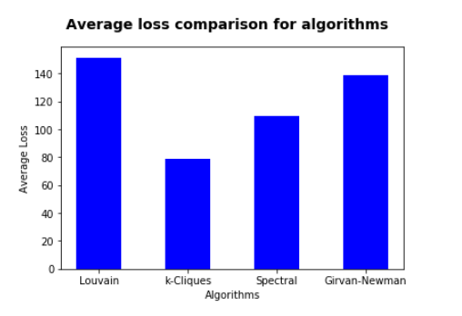
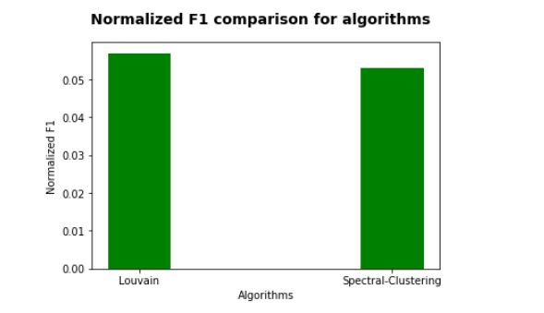
Comparative results

Slide 18
Things that worked
Used loss function (provided in Learning Social Networks Kaggle Competition) as the evaluation metric for the algorithms.
Filtering out the graphs (egonets) that have edges less than 2300 (the mean of all the edges) worked for the k-clique algorithm

Slide 19
Things that did not work
Could not calculate normalized F1 due to empty ground truth files and empty predictions.
Hierarchical clustering was computationally expensive. Also, it required predefined cluster value which did not suit our problem statement.
Tried plotting the entire network (all edges, and all ego nodes) using Gephi but the visualization was not clear and understandable. The plot was difficult to decipher and we had to discard it.

Slide 20


